Slide 1
Values and Behavioral Flexibility: What are the effects of valuing on sensitivity to contingencies of reinforcement?
Gina Q. Boullion
Nolan R. Williams
Emily K. Sandoz, Ph.D.
Louisiana Contextual Science Research Group
Notes:
This page is an opening page option.

Slide 2
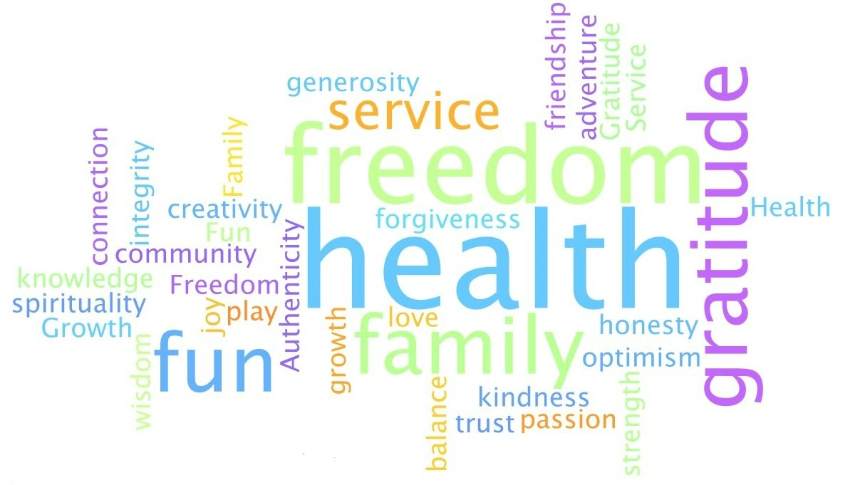

Slide 3
Values: Freely chosen, verbally constructed consequences of ongoing dynamic, evolving patterns of activity which establish predominant reinforcers for that activity that are intrinsic in engagement in the valued behavioral pattern itself.

Slide 5
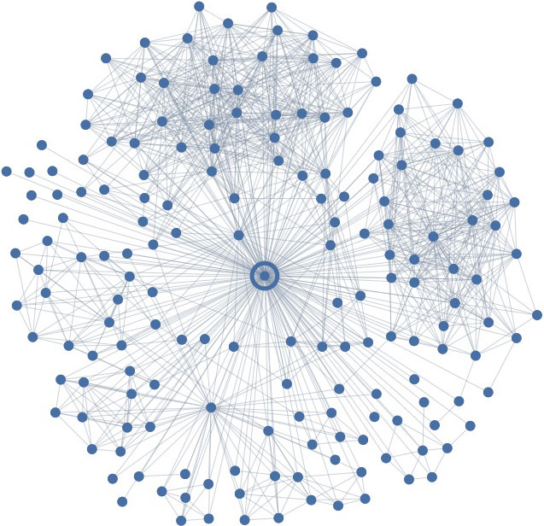

Slide 7
Methods
Experimental Group (n=24)
Control Group
(n=13)
Values writing task
Match to sample
Computer game
Values writing task
Computer game

Slide 8
Experimental Group
5 minute values writing task
Chose 3 value words and 3 fused value words, 3 neutral words added in.
V1 FV1 N1 (pencil)
V2 FV2 N2 (wall)
V3 FV3 N3 (shoe)

Slide 9
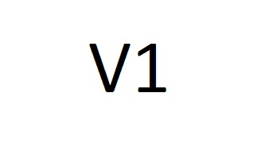
Experimental Group
Press the F key to pull the image closer and the J key to push the image away
Words used in next phase:
V most approached
FV most avoided
N with least activity

Slide 10
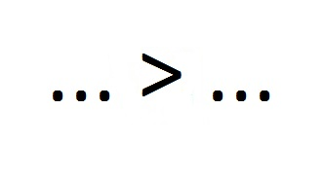
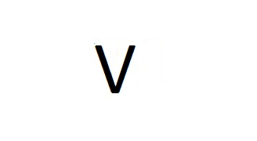
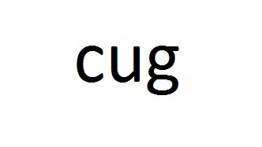
Experimental Group

Slide 11
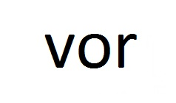
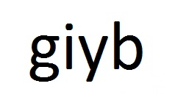
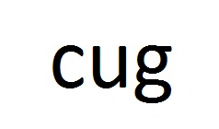
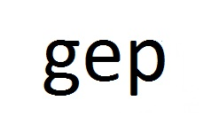
Game
6 Trials
10 Clicks
Total Points
2 points!
10 points!
7 points!
5 points!

Slide 12
Did folks who underwent training perform better or worse in the game than those who did not undergo any training?

Slide 13
Did points earned vary depending on the configuration of points available for each response?

Slide 16
Did we see this same trend in the control group?

Slide 18
Contact:
ginaqboullion@gmail.com
nrwilliams42@gmail.com
Louisiana Contextual Science Research Group
Notes:
This page is an opening page option.

